Slide 1
Coach Miller’s PE CLASS 22-23
CLASS Outline
World’s Best Teacher

Slide 2
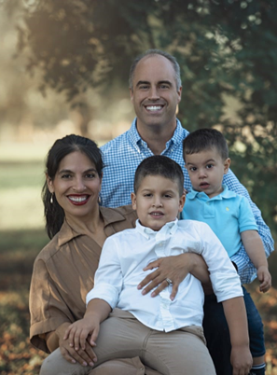
ABOUT ME
This is my 2nd year @ T.H. Rogers. 14th in education.
I’m married and have two beautiful boys.
I enjoy outdoor activities: jogging and yardwork
I coach Girls basketball @ Rogers
1
2
3
4

Slide 3
Activities
1
We will participate expose your child to many sports and activities
Volleyball & Swimming
Pickleball & Badminton
Soccer & Lacrosse
Basketball & Frisbee
Kickball & Floor Hockey
2
3
4
5
6

Slide 4
Grading
Classroom Expectations/Grading: Your child is required to dress out in a school approved PE uniform. Wearing your PE uniform for class gives your child 5 points out of 10(each class period). The other 5 points are based on their completion of the daily lesson. Your child is graded on(other 5 points) their effort and attitude and not necessarily their performance. My students all have different physical ability levels. If your child gives themselves and me their best practices, effort, and positive attitude he/she will do fantastic in my classroom. My goal is for ALL STUDENTS to find a LOVE for physical fitness/exercise. Physical fitness needs to be apart of our daily lives. I’m focused on developing lifelong physical fitness learners

Slide 5
PE SCHEDULE
1
2
3
I will see your child either twice/three times according to the schedule
We will focus on testing components muscular strength, cardiovascular endurance, and flexibility.
We will text every six weeks. Your child is expected to show growth each testing cycle

Slide 6
Classroom Expectations
Be respectful of classmates and me
Do your best!
Do not make excuses!
Give you best effort and attitude!
1
2
3
4
5

Slide 7
Parent Communication
1
2
Please email
bmille11@houstonisd.org
Looking forward to working with your child!

